Slide 1
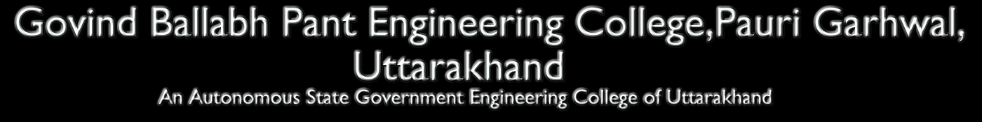

Speaker Recognition Using MFCC and TDA
Supervisor: Mr. Rameh Kumar
Brij Mohan Purohit 970724502
Arjun Joshi 199902260
Ankur Bharti 199902258
Ashish Mathur 199904062

Slide 2
Overview
Introduction.
Main principles of speaker recognition.
Selected Method.
Speaker recognition Models.
Feature Extraction.
Feature Extraction Implementation.
Conclusion.

Slide 3
INTRODUCTION

Slide 4
Introduction
Speech is the process of automatically recognizing a certain word spoken by a particular speaker based on individual information in speech voice.
Design and implement an automatic voice recognition system.

Slide 5
Main principle of Speaker Recognition
Identification
Verification

Slide 6
Speaker Recognition methods
Text Dependent :
For speaker identity is based on his/ her speaking one or more specific phase.
Text Independent:
Speaker models capture characteristics of somebody’s speech which show up irrespective of what one is saying.

Slide 7
Selected Method
Text Independent:
  Identify the person who speaks regardless to what is saying.

Slide 8
Speaker recognition Models
Feature Extraction
Feature Matching

Slide 9
Speech Feature Extraction
That extracts a small amount of data from the voice signal that can later be used to represent each speaker.
MFCC: is based on the known variation of the human ear’s critical bandwidths with frequency, filters spaced linearly at low frequencies and logarithmically at high frequencies.

Slide 10
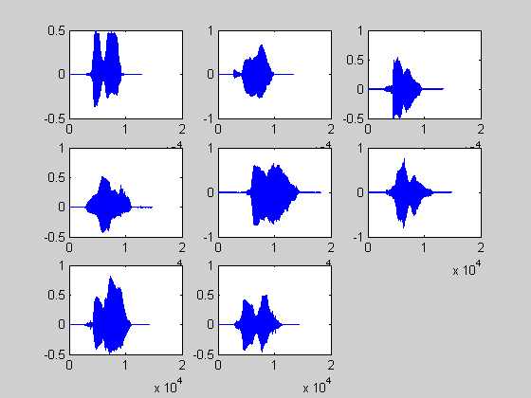
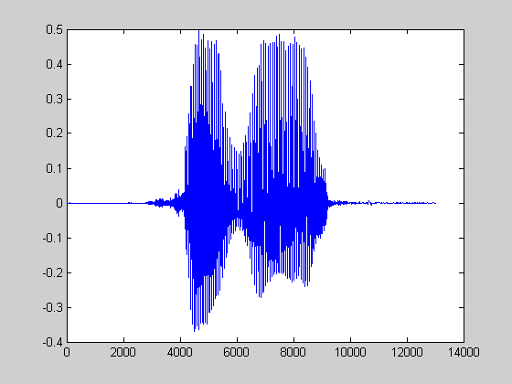
Input Speech Signals
‘ze’
‘ro’
There are silence at the beginning and at the end of the signals.
The word consists of two syllables.

Slide 11
Frame Blocking
Continuous
speech
Frame
Blocking
frame
Windowing
FFT
spectrum
Cepstrum
Mel-frequency
wrapping
Continuous speech signal is blocked into frames of N samples with adjacent frames being separated by M(M<N).
Frame1 Consist of First N samples.
Frame2 Begins M samples after first frame, and the overlaps it by N-M samples.
Frame3 Begins 2M samples after the first frame, and the overlaps it by N-2M samples.

Slide 12
Frame Blocking
Continuous
speech
Frame
Blocking
frame
Windowing
FFT
spectrum
Cepstrum
Mel-frequency
wrapping
Continuous speech signal is blocked into frames of N samples with adjacent frames being separated by M(M<N).
Frame1 Consist of First N samples.
Frame2 Begins M samples after first frame, and the overlaps it by N-M samples.
Frame3 Begins 2M samples after the first frame, and the overlaps it by N-2M samples.

Slide 13
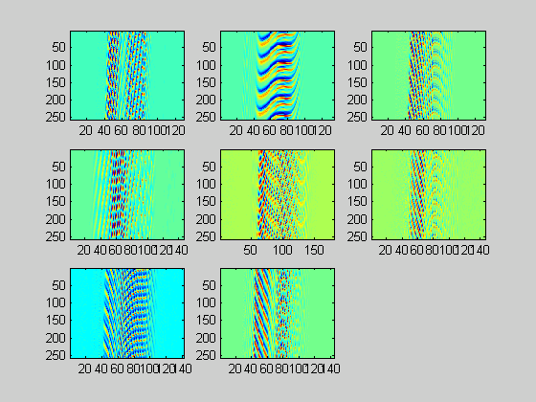
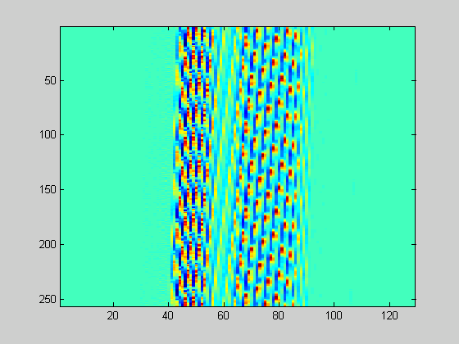
After Frame Blocking
The speech signals were blocked into frames of N samples with overlap.

Slide 14
Windowing
Continuous
speech
Frame
Blocking
frame
Windowing
FFT
spectrum
Cepstrum
Mel-frequency
wrapping
Each individual frame will be windowed.
Hamming window is used in this project.

Slide 15
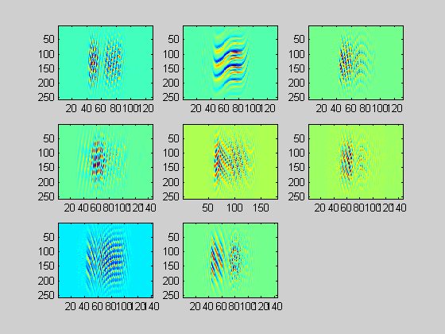
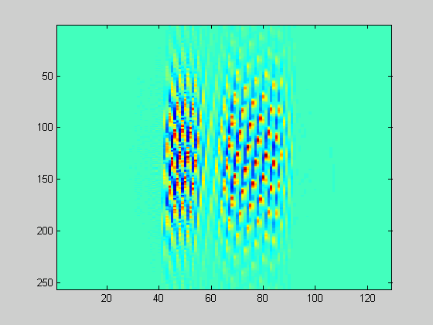
After Windowing

Slide 16
Before Windowing After Windowing

Slide 17
After Windowing
Continuous
speech
Frame
Blocking
frame
Windowing
FFT
spectrum
Cepstrum
Mel-frequency
wrapping
Convert each frame of N samples form time domain into the frequency domain.

Slide 18
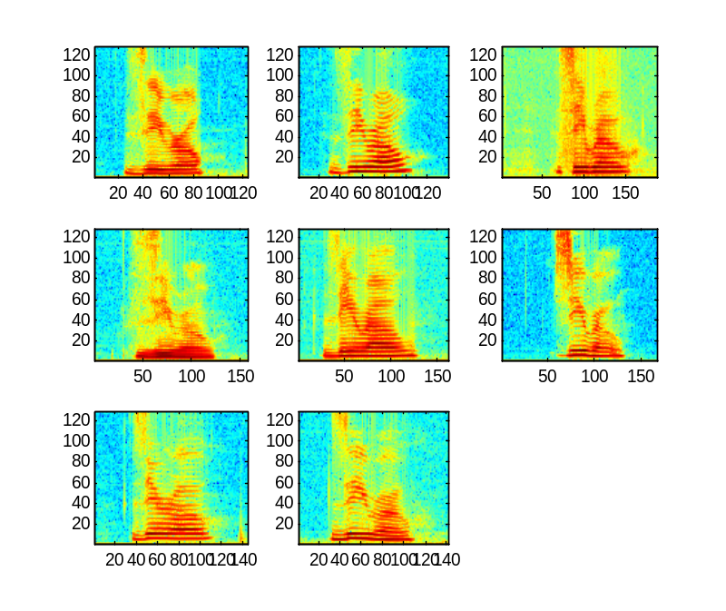
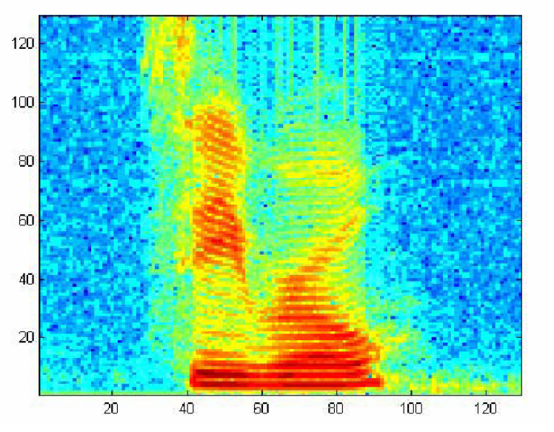
Log Scale of S1 speech wave

Slide 19
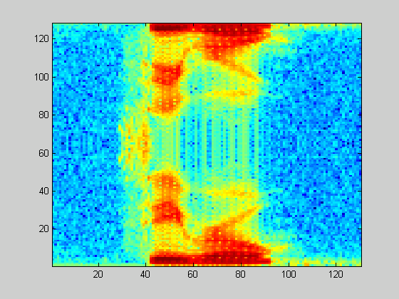
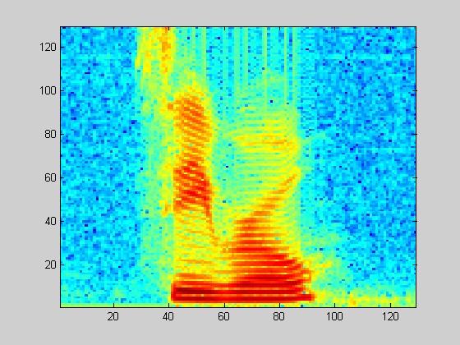
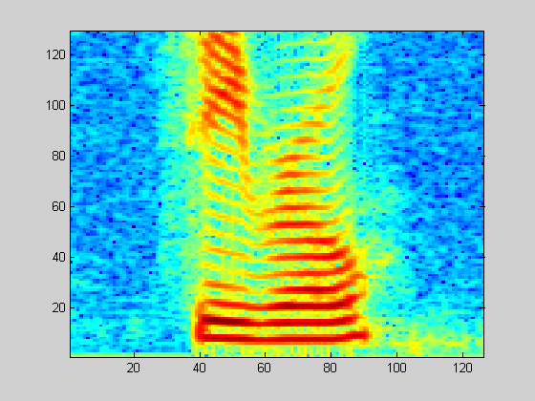

Slide 20
After Windowing
Continuous
speech
Frame
Blocking
frame
Windowing
FFT
spectrum
Cepstrum
Mel-frequency
wrapping
Mel frequency scale is a linear frequency spacing below 1KHz and a logarithmic spacing above 1KHz.
Filter Bank.

Slide 21
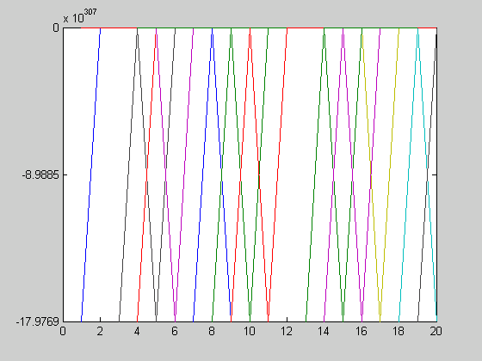
Mel –Spaced Filter Bank

Slide 22
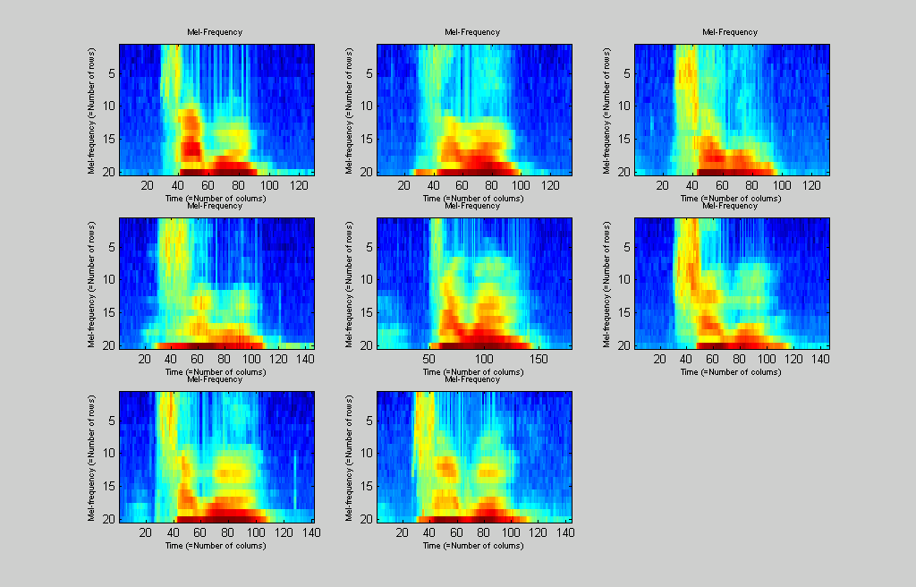
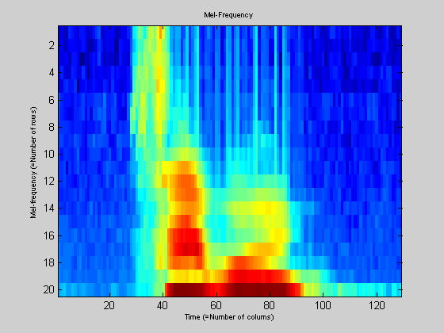
Mel-Frequency Wrapping

Slide 23
Before Mel-Frequency wrapping After Mel-Frequency wrapping

Slide 24
After Windowing
Continuous
speech
Frame
Blocking
frame
Windowing
FFT
spectrum
Cepstrum
Mel-frequency
wrapping
Convert the log mel spectrum back to Time domain.

Slide 25
Implementation of ARS by using two approaches:
MFCC Approach
Time Domain Analysis

Slide 26
Conclusion

